Slide 1

Realizacija iot Sistema na bazi esp32, influxdb I Grafana platforme
STUDENT:
ALEKSA MITROVČAN
MENTOR:
IVAN MEZEI

Slide 2
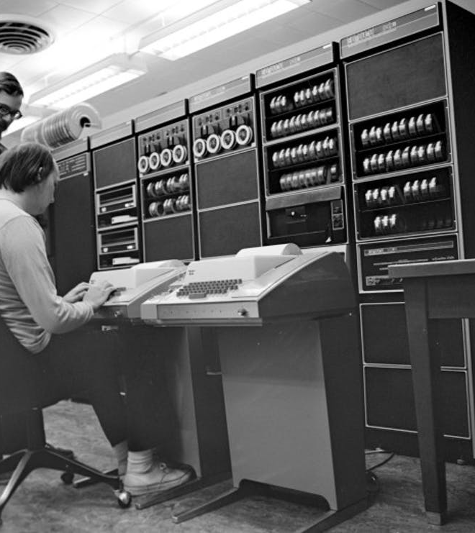
CONTENT
Internet of things
Esp32
sensors
Influxdb
Grafana
alerts

Slide 3

Internet of things

Slide 4
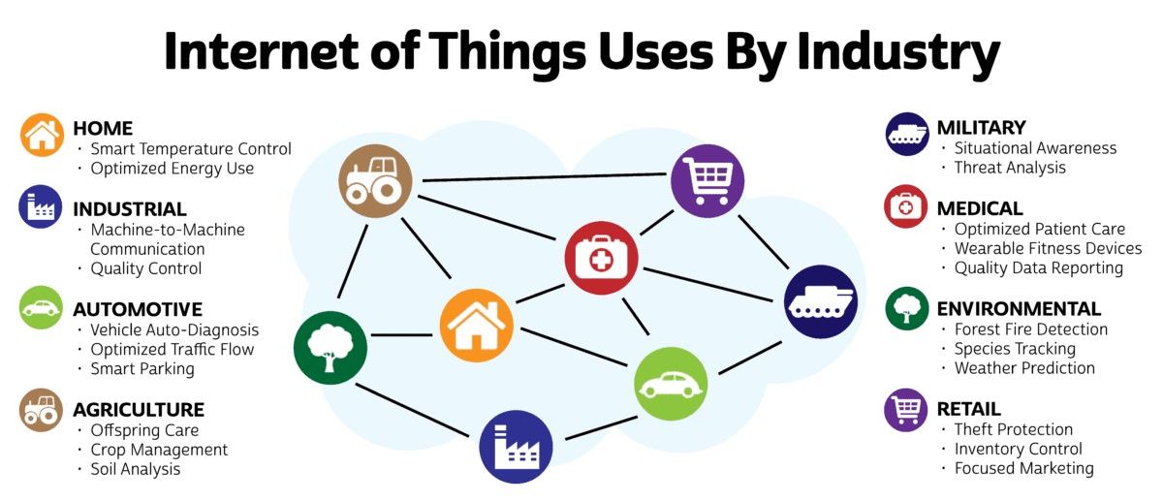

Slide 5
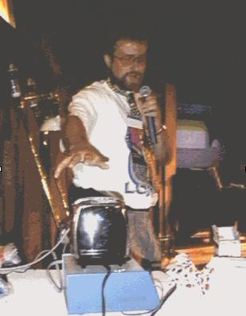
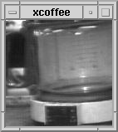
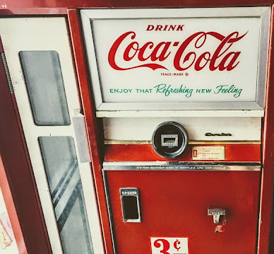
1989.
1991.
1982.

Slide 6






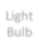
Communication models
Device-To-Device communication
Light
Wireless
Light
Bulb
Network
Switch
Manufacturer A
Bluetooth,Z-Wave,ZigBee
Manufacturer B
<
>)

Slide 7
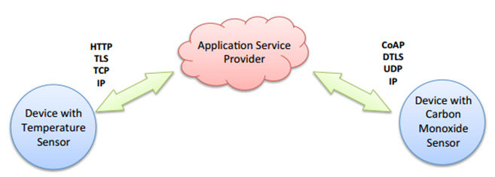
Communication models
Device-To-Cloud communication

Slide 8
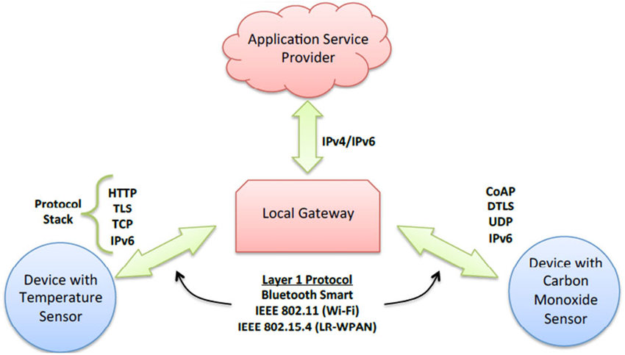
Communication models
Device-To-Gateway communication

Slide 9
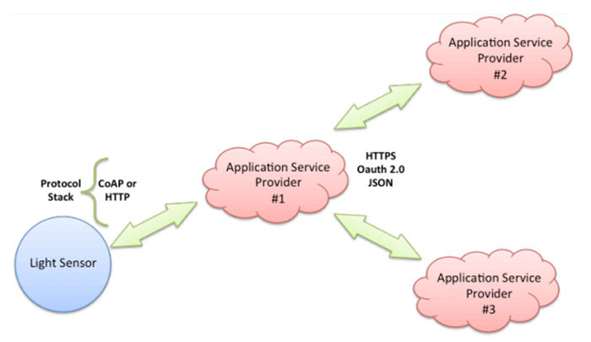
Communication models
Back-End-Data-Sharing model

Slide 10
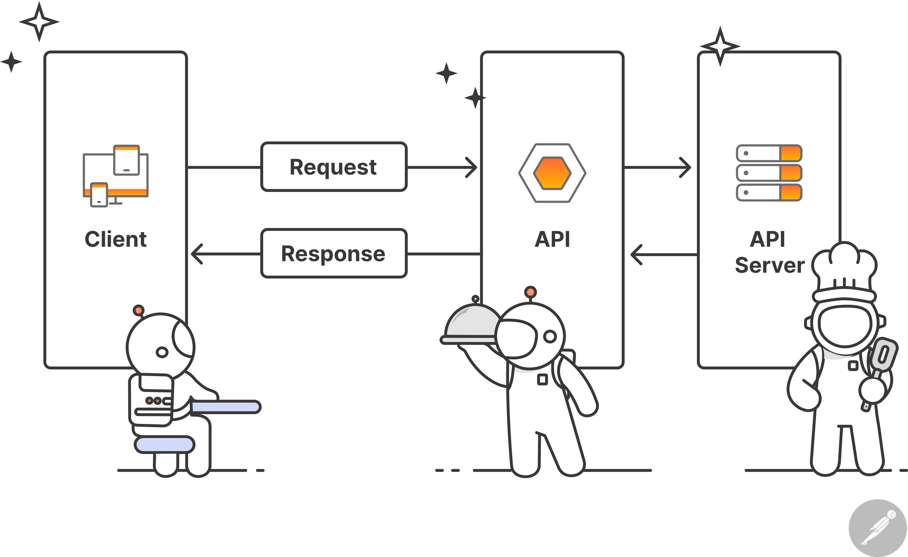
Api’S
Endpoint
Method
Parameters
Request headers
Request body

Slide 11
ESP32 MICROCONTROLLER

Slide 12
o Dual-Core 32-bitni MCU +
448 KB ROM + 520 KB SRAM +
4MB FLASH
o WiFi modul
o Bluetooth modul
o Kriptografski akcelerator
o RTC modul
o Periferijski moduli

Slide 13
Consumption with radio on
Consumption in sleep modes
Mode | Consumption
Transmit 802.11b | 240 mA
Transmit 802.11g | 190 mA
Transmit 802.11n | 180 mA
Receive WiFi | 100 mA
Transmit BT | 130 mA
Receive BT | 100 mA
Mode | Consumption
Light-Sleep | 800 uA
Deep-Sleep with ULP | 160 uA
Deep-Sleep without ULP | 10uA
Hibernation | 5uA
Power off | 1uA

Slide 14
SENSORS

Slide 15
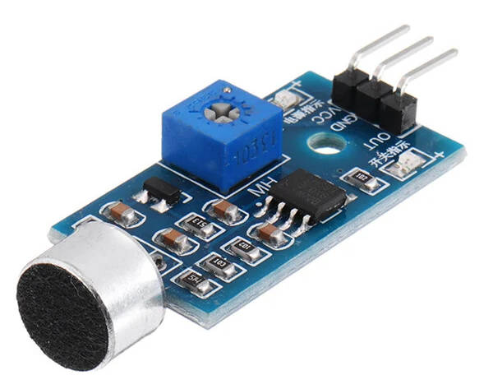
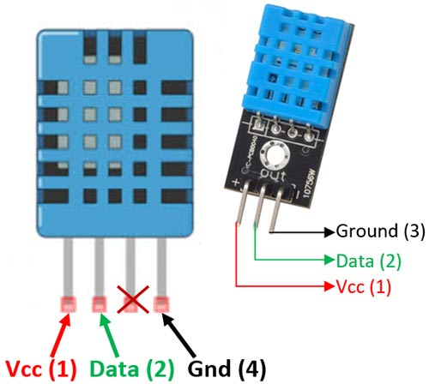
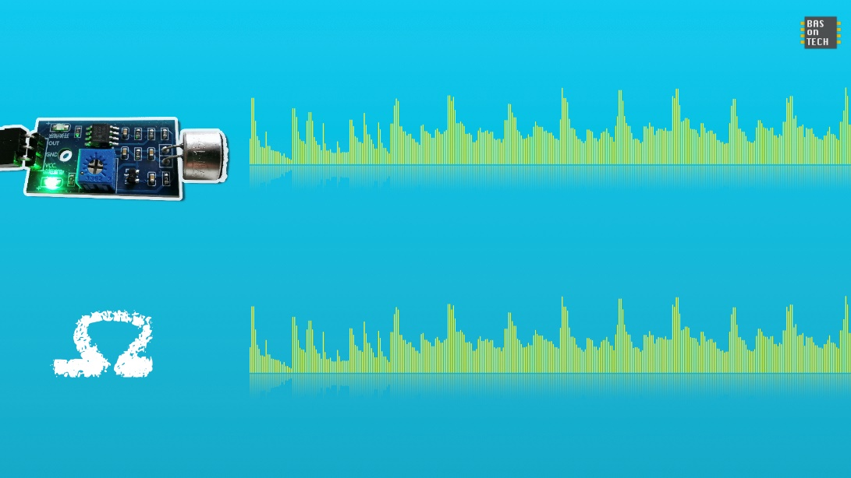
DHT11 TEMPERATURE AND HUMIDITY SENSOR
SOUND SENSOR CZN-15E

Slide 16
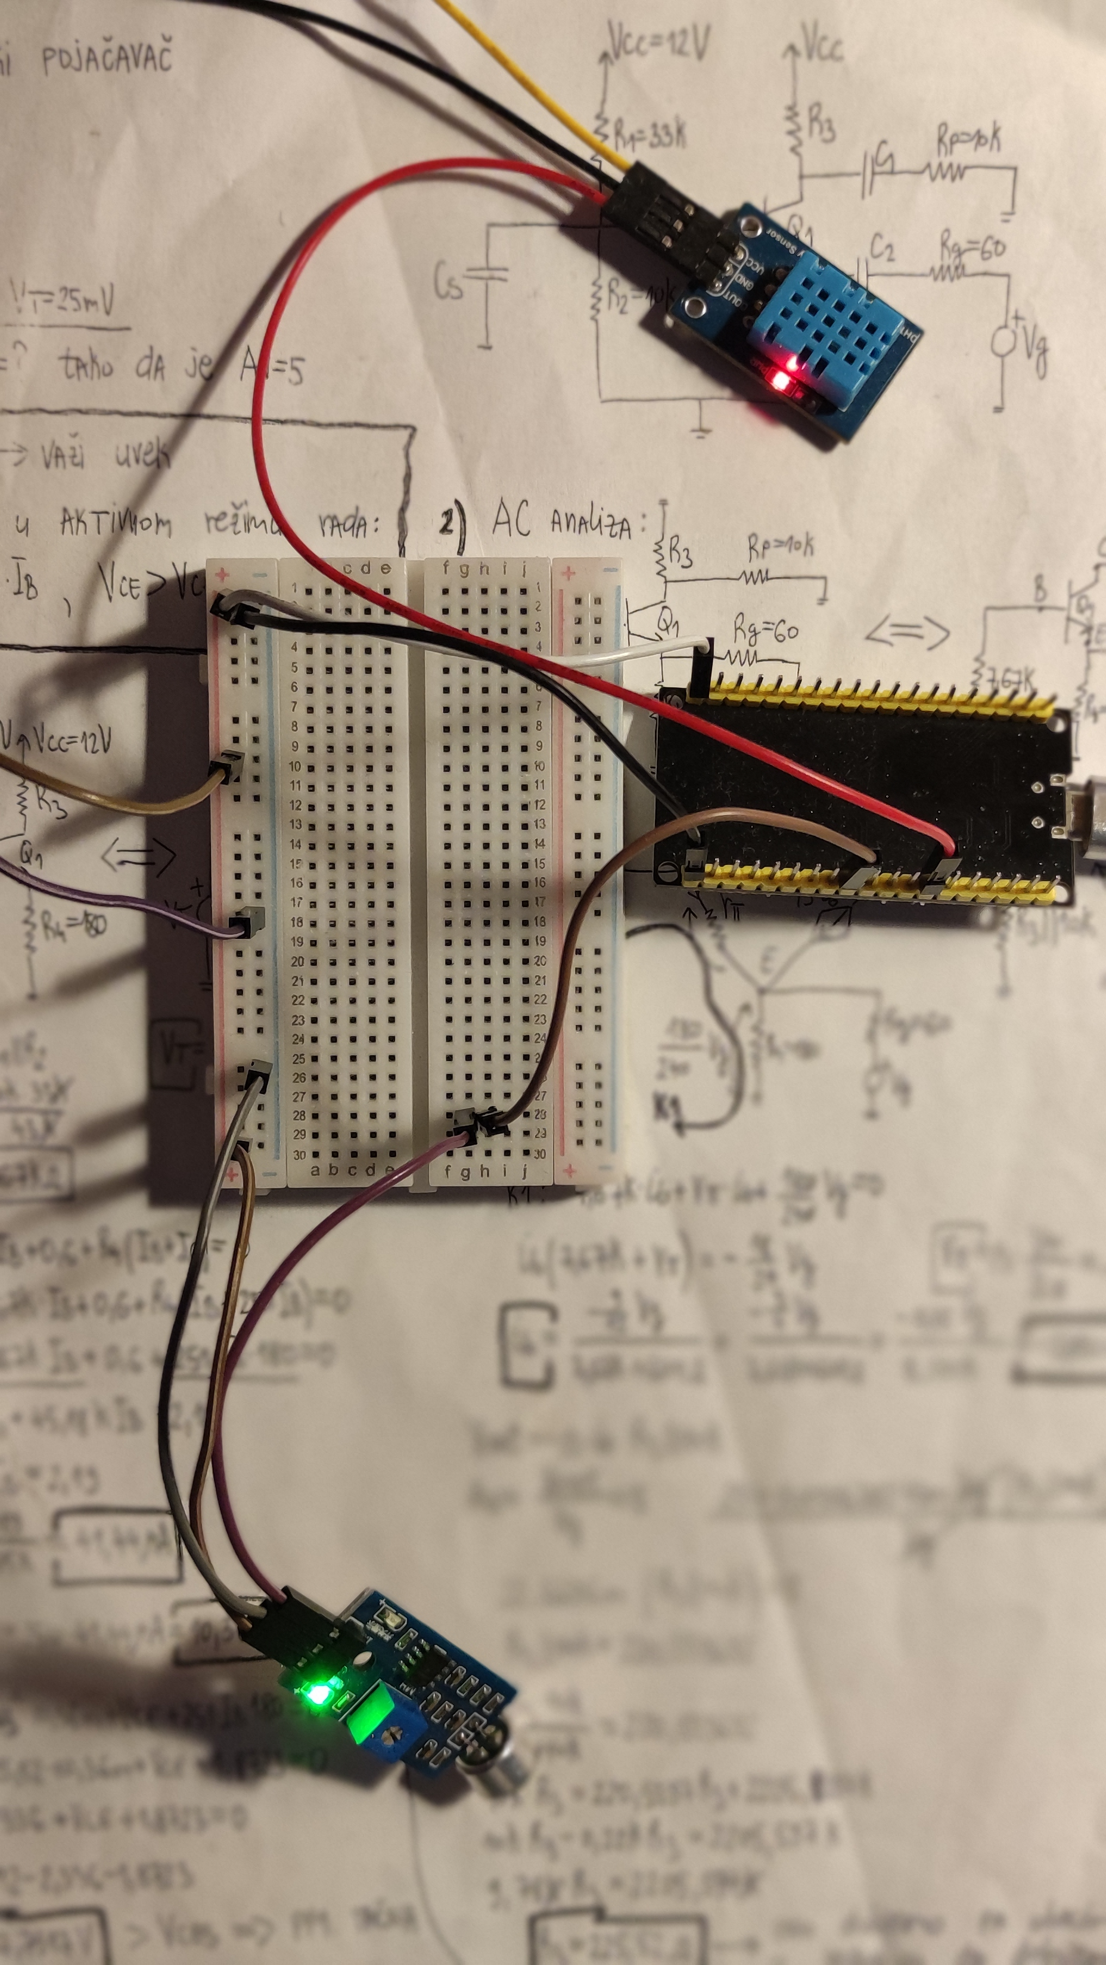
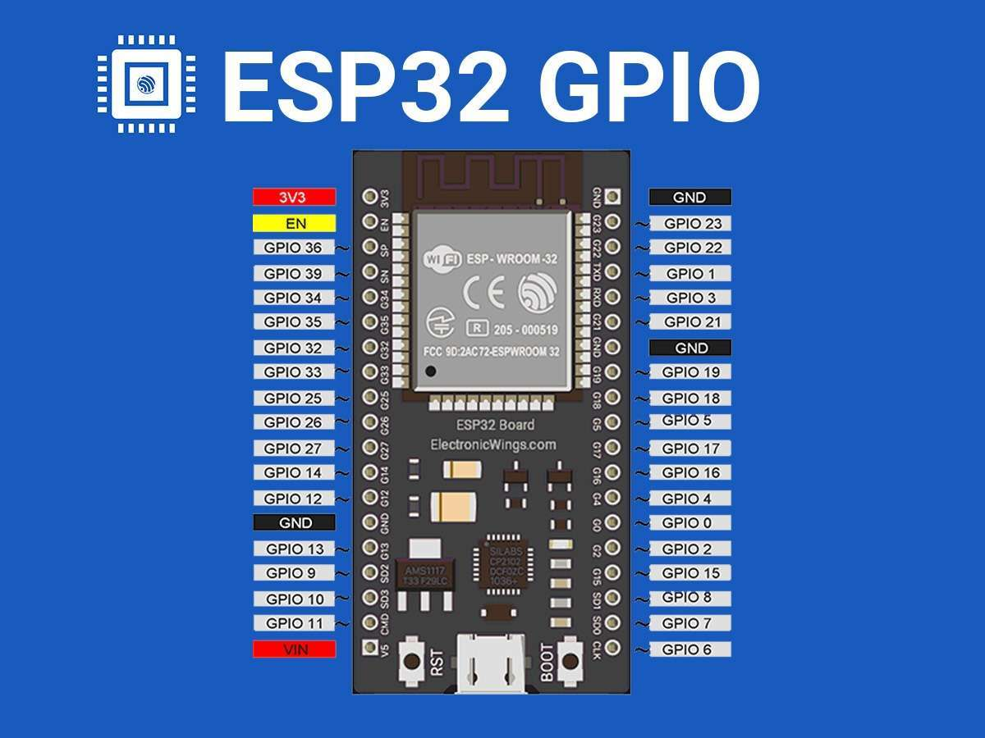

Slide 17
influxdb

Slide 18
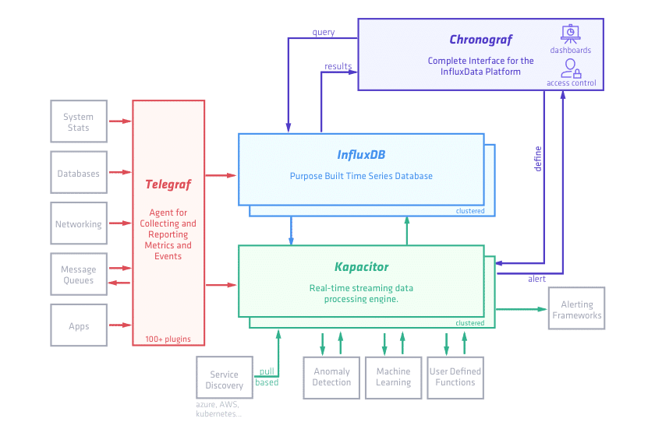

Slide 19
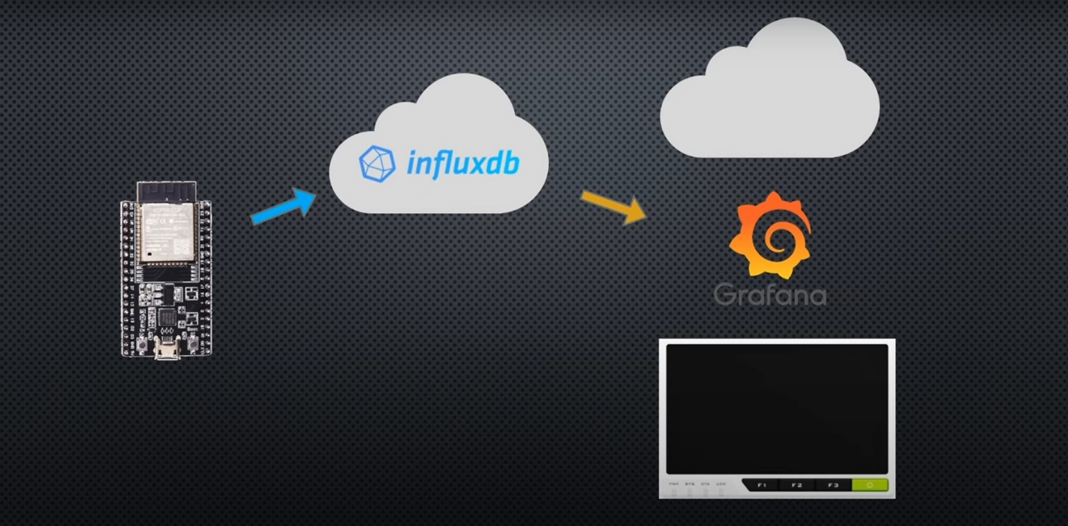

Slide 20
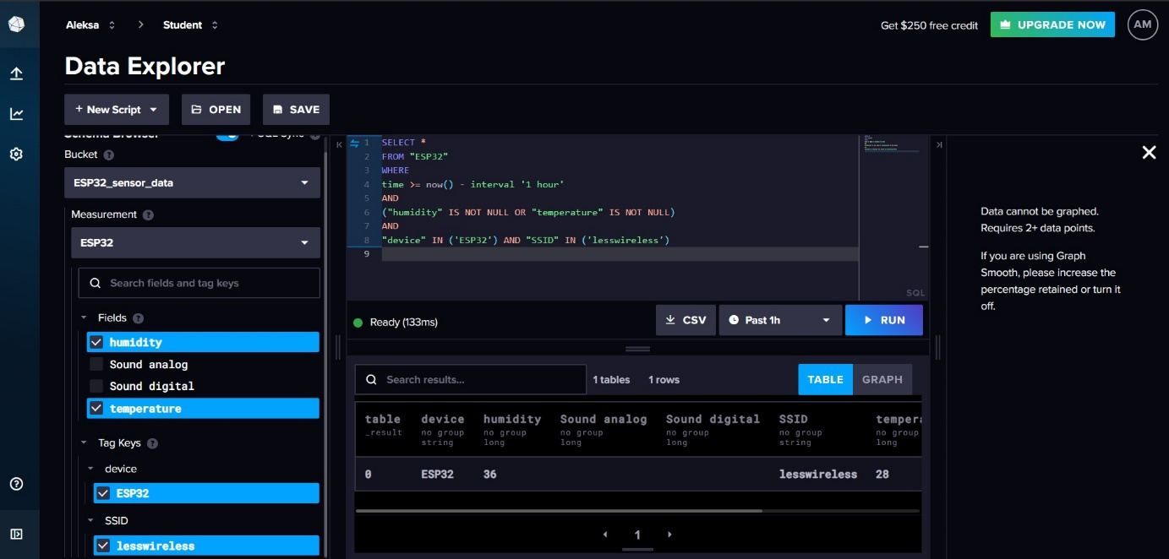
#define WIFI_SSID "lesswireless"
#define WIFI_PASSWORD "**********"
#define INFLUXDB_URL "https://eu-central-1-1.aws.cloud2.influxdata.com"
#define INFLUXDB_TOKEN "4U6dWd2BYjiHeYf1WGqQ1vUcYLuJVkSzUQVG9e5JVcbBfrHcpwfhlkevrEAEIMncJfYfdU-NJ0mrupXsL2RYtg=="
#define INFLUXDB_ORG "91b1603cf9d889a5"
#define INFLUXDB_BUCKET "ESP32_sensor_data"
#define TZ_INFO "CET-1CEST,M3.5.0,M10.5.0/3"

Slide 21
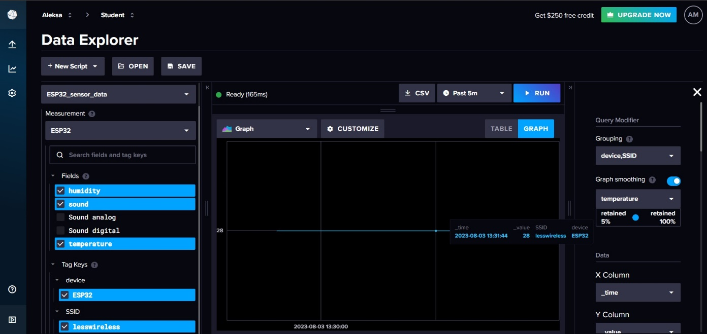

Slide 22
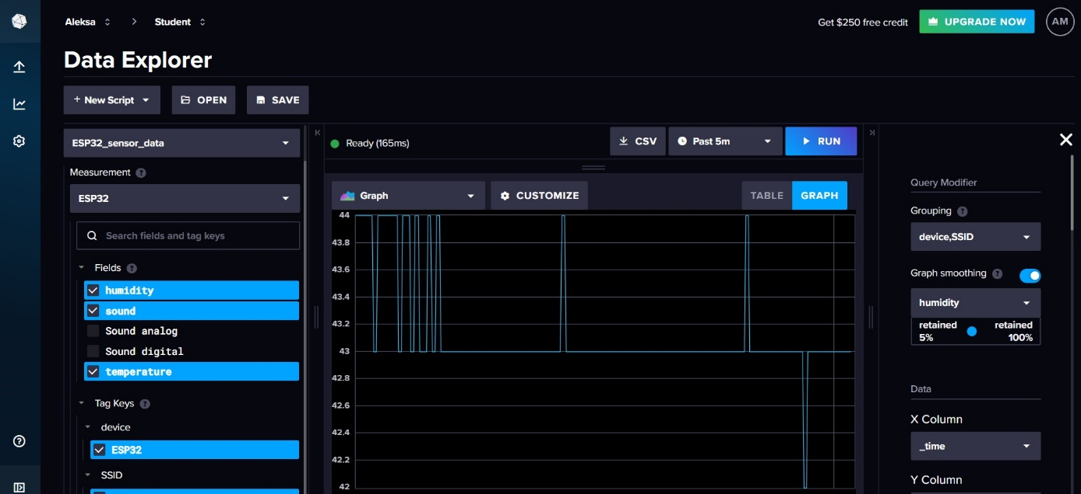

Slide 23
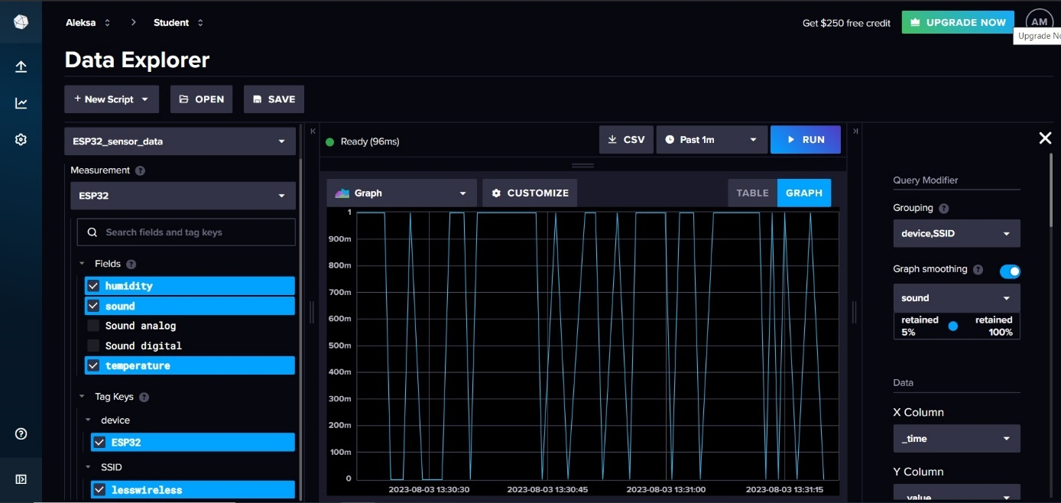

Slide 24
GRAFANA

Slide 25
from(bucket: "ESP32_sensor_data")
|> range(start: -1d)
|> filter(fn : (r) => r._field == "temperature")
|> yield(name: "_results")

Slide 26
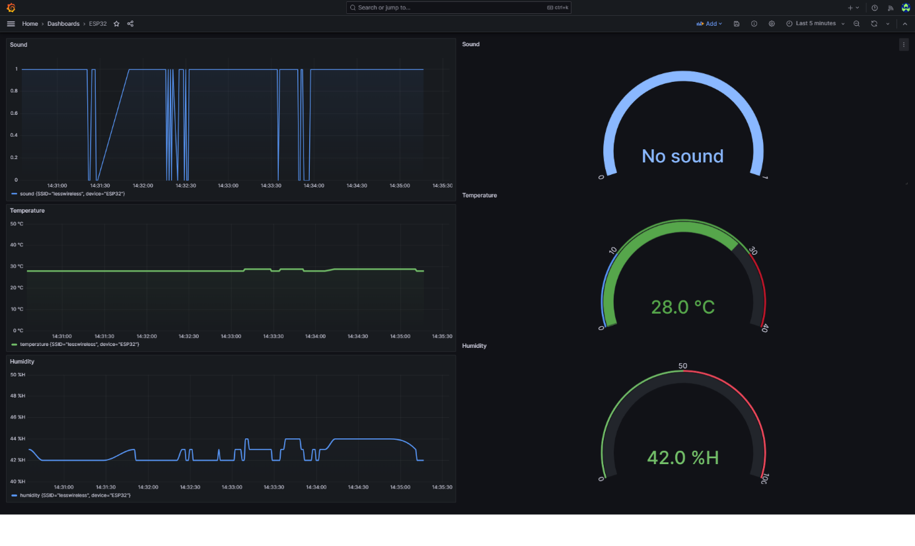
Dashboard with no alarms

Slide 27
alerts

Slide 28
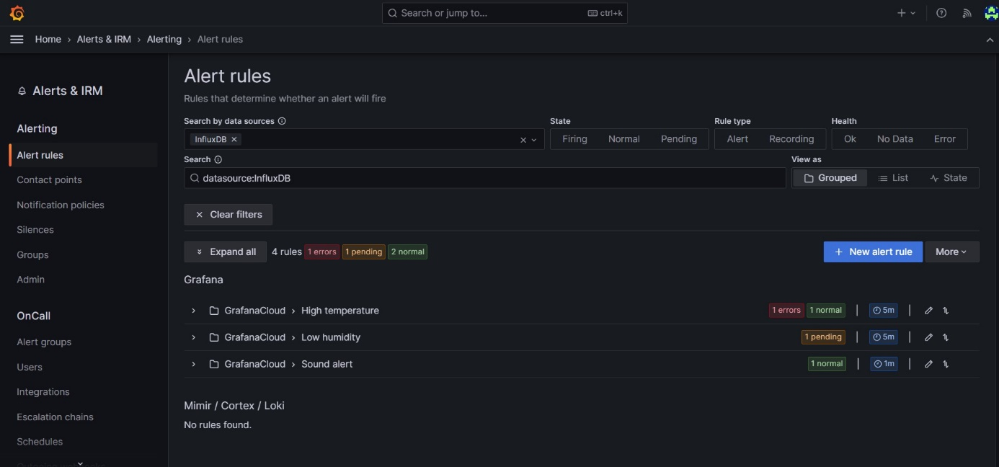

Slide 29
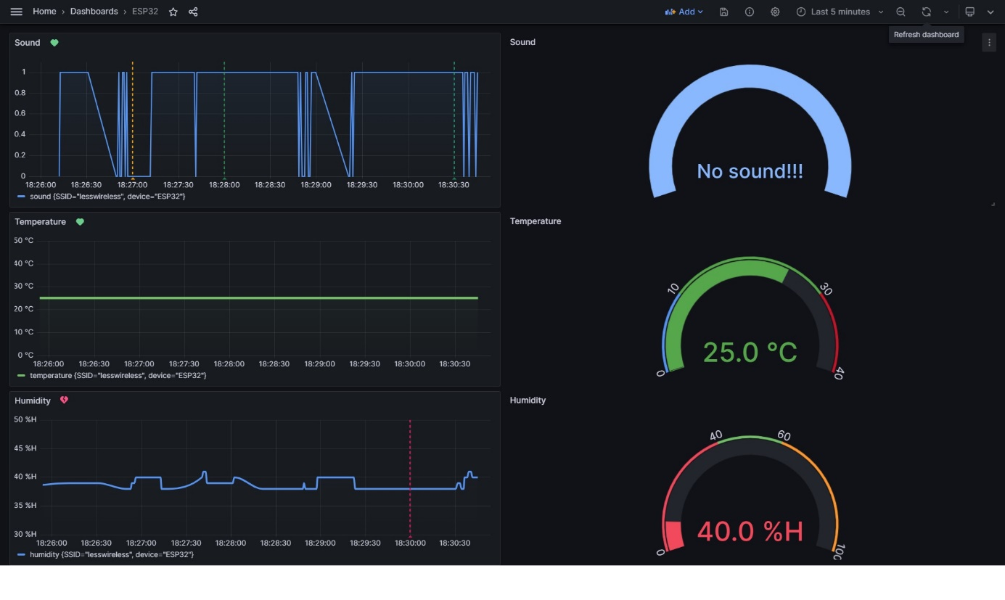
Dashboard with alarms

Slide 30
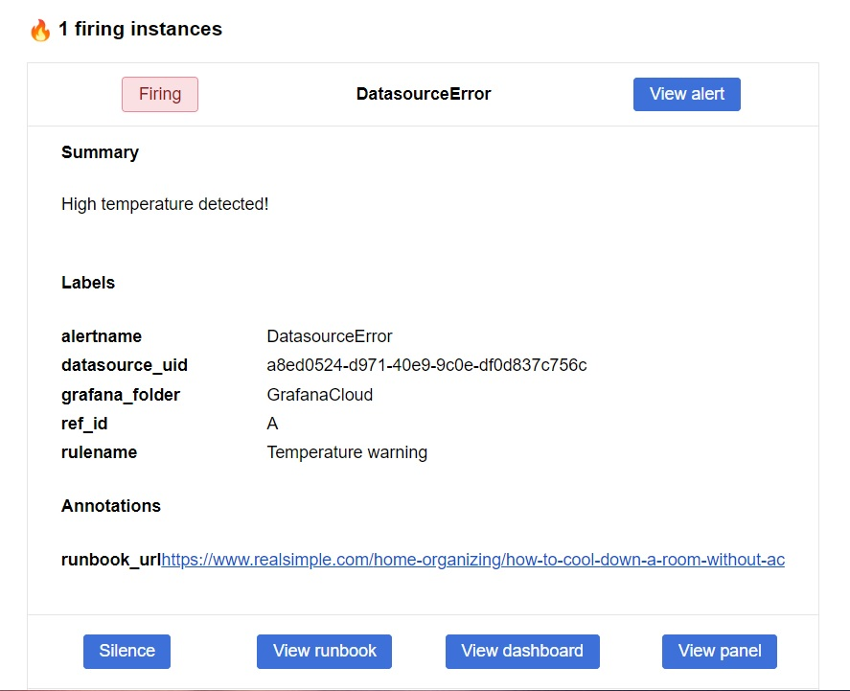
High temperature alarm

Slide 31
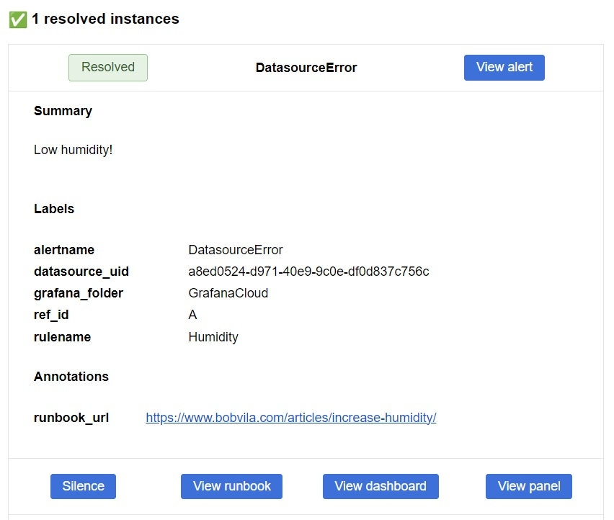
Issue with humidity resolved

Slide 32

HVALA NA PAŽNJI!
Aleksa Mitrovčan
https://alex64a.netlify.app/

